Slide 1


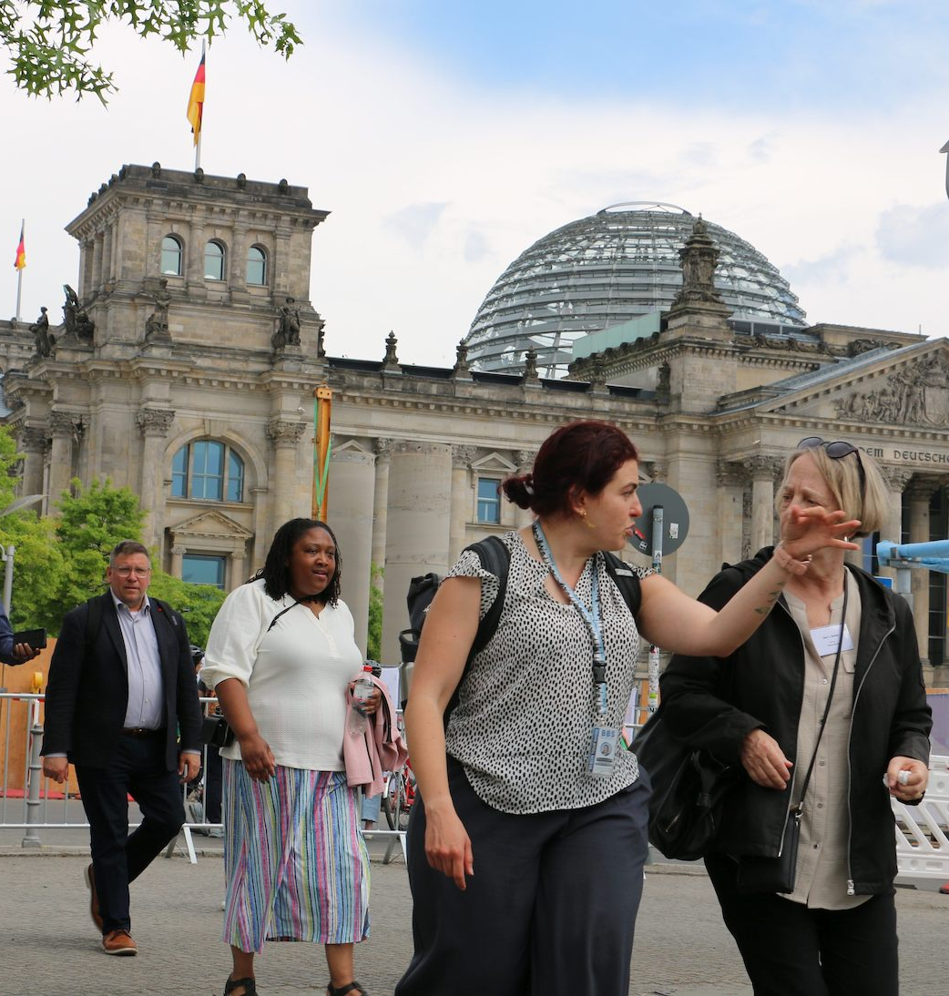

Berlin Leadership Insights

Slide 2
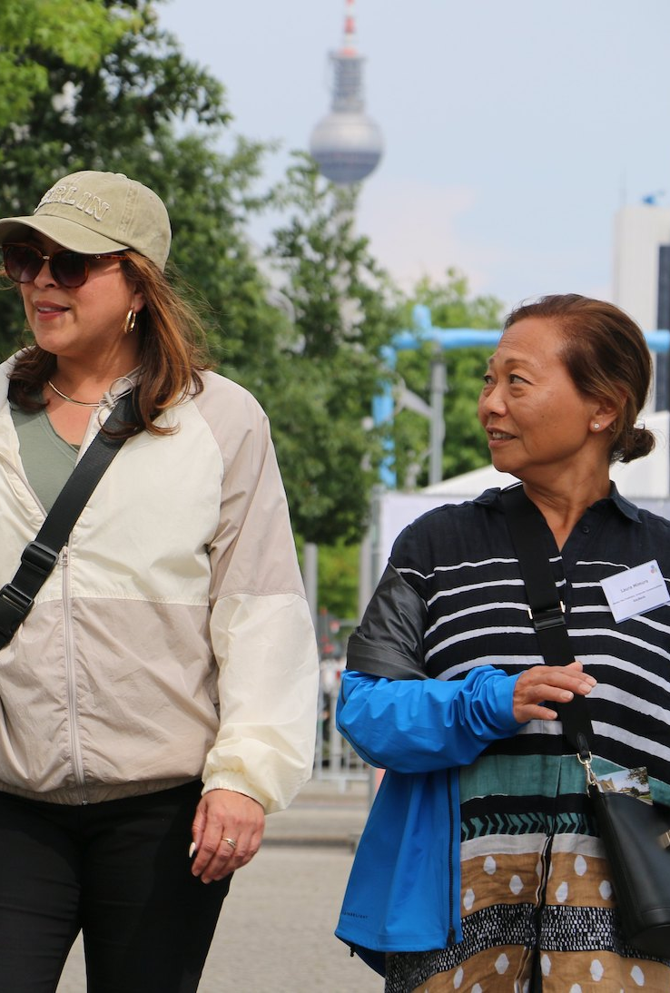
Overview
  Welcome & Introductions
  Agenda Overview
  Travel Practicalities
    Electronics
    Technology/Apps
  Questions

Slide 3
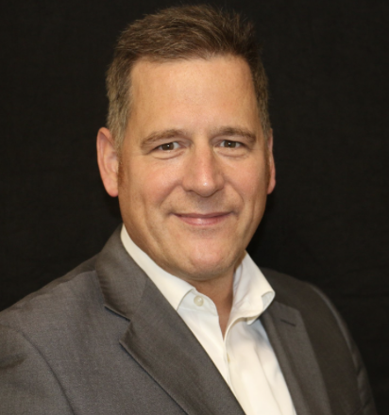
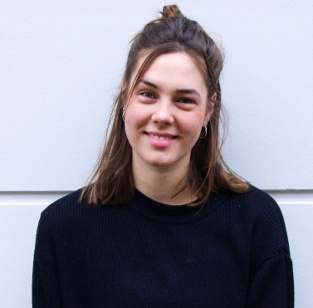

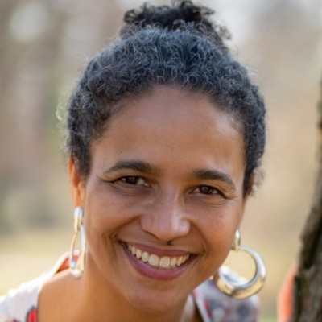
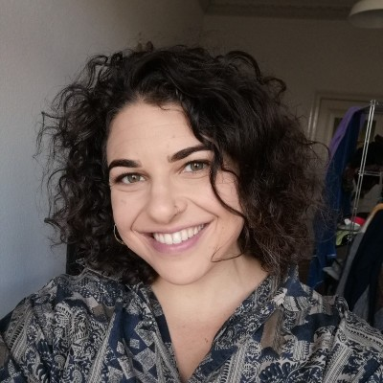

Our Team
Bernhard Heider
Ronja Höver
Natalie Yakunich
Eka Neumann
Hannah Schneider
Managing Director
Co-Founder of Leadership Berlin and has served as managing director of the association since 2012.
Program Coordinator
Supports the conception, coordination, and implementation of Collaborative Leadership Program.
Insights Fellow
Cleveland Leadership Alumni, and recent immigrant to Berlin. Supports the Berlin Leadership Insights week.
Executive Coaching
Discrimination-sensitive coach who engages participants with context, perspective, and thoughtful dialogue about Germany.
Tour Guide & Podcast Host
A California native with an MA in History Warfare, has lived in Berlin since 2018 and regularly leads U.S. groups on tours.

Slide 4

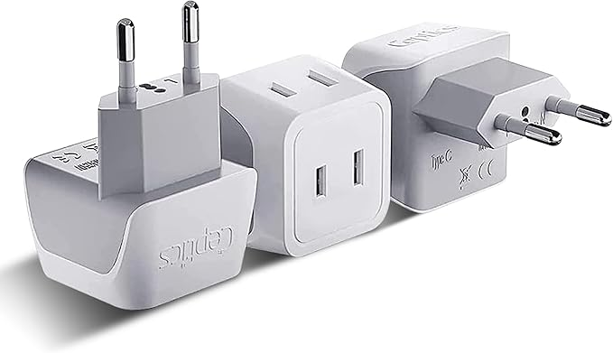
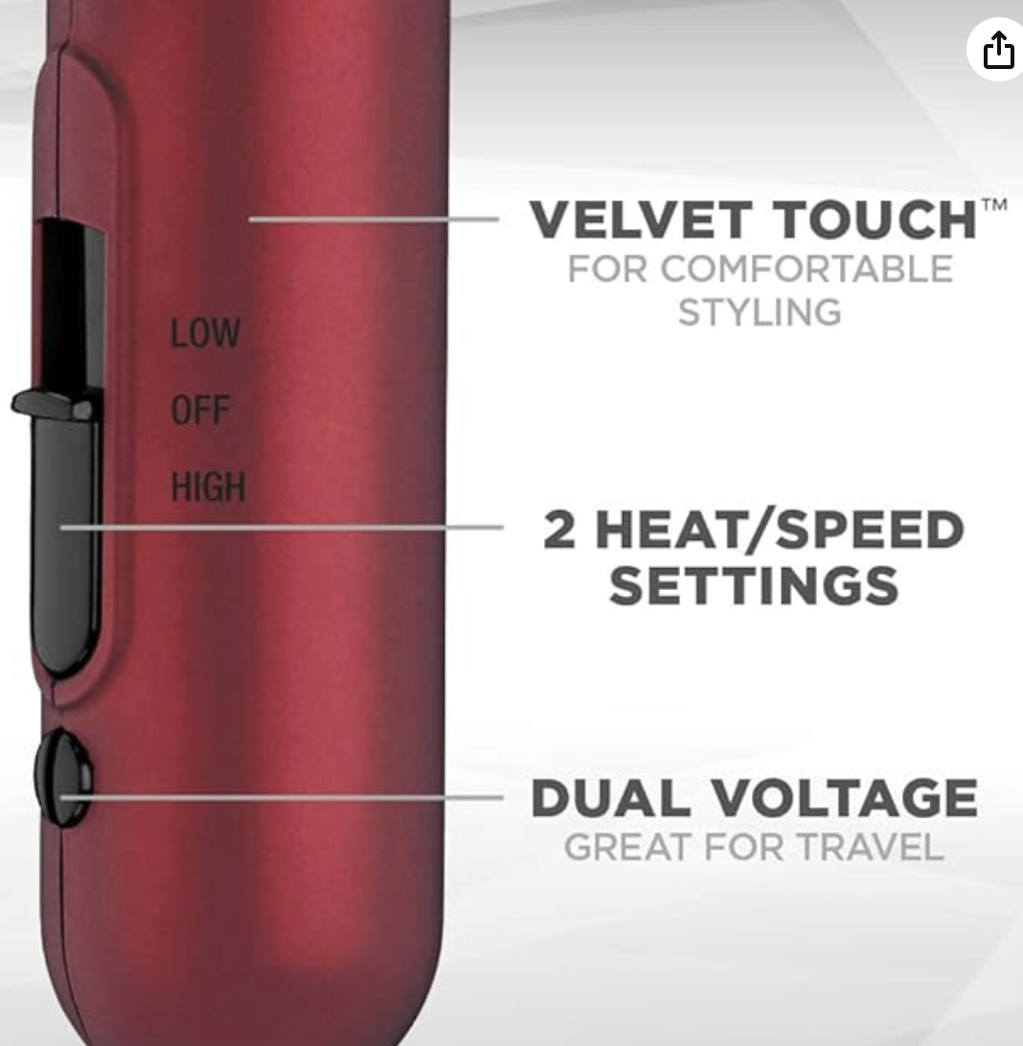


Adaptor
Small device that allows you to plug your electrical devices into power outlets with a different socket shape.
-Dual voltage devices (phones, laptops, etc.) only require an adaptor
Practicalities
Adaptor or Converter?
Converter
A device that changes the electrical voltage from the power supply to match what your device needs.
-Devices that are not dual voltage will require a converter (hairdryer, hair styling tools, etc.)

Slide 5
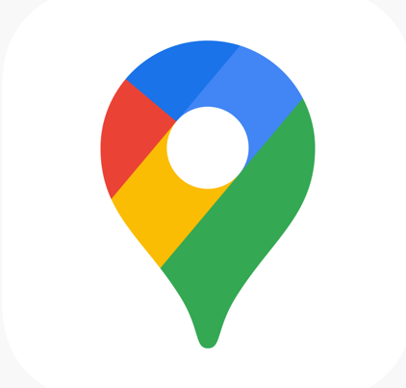


Suggested Apps
Google Maps
Google Translate
WhatsApp
Public Transportation Routing
Translation Support
Messaging

Slide 6

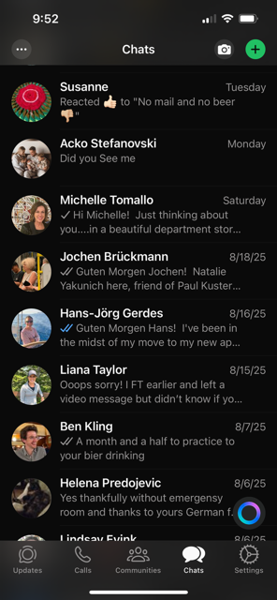
Suggested Apps
  Download app
  Verify Your Phone Number
  Set Up Your Profile (include pic)
  Allow permissions
  Join our group!
WhatsApp

Slide 7
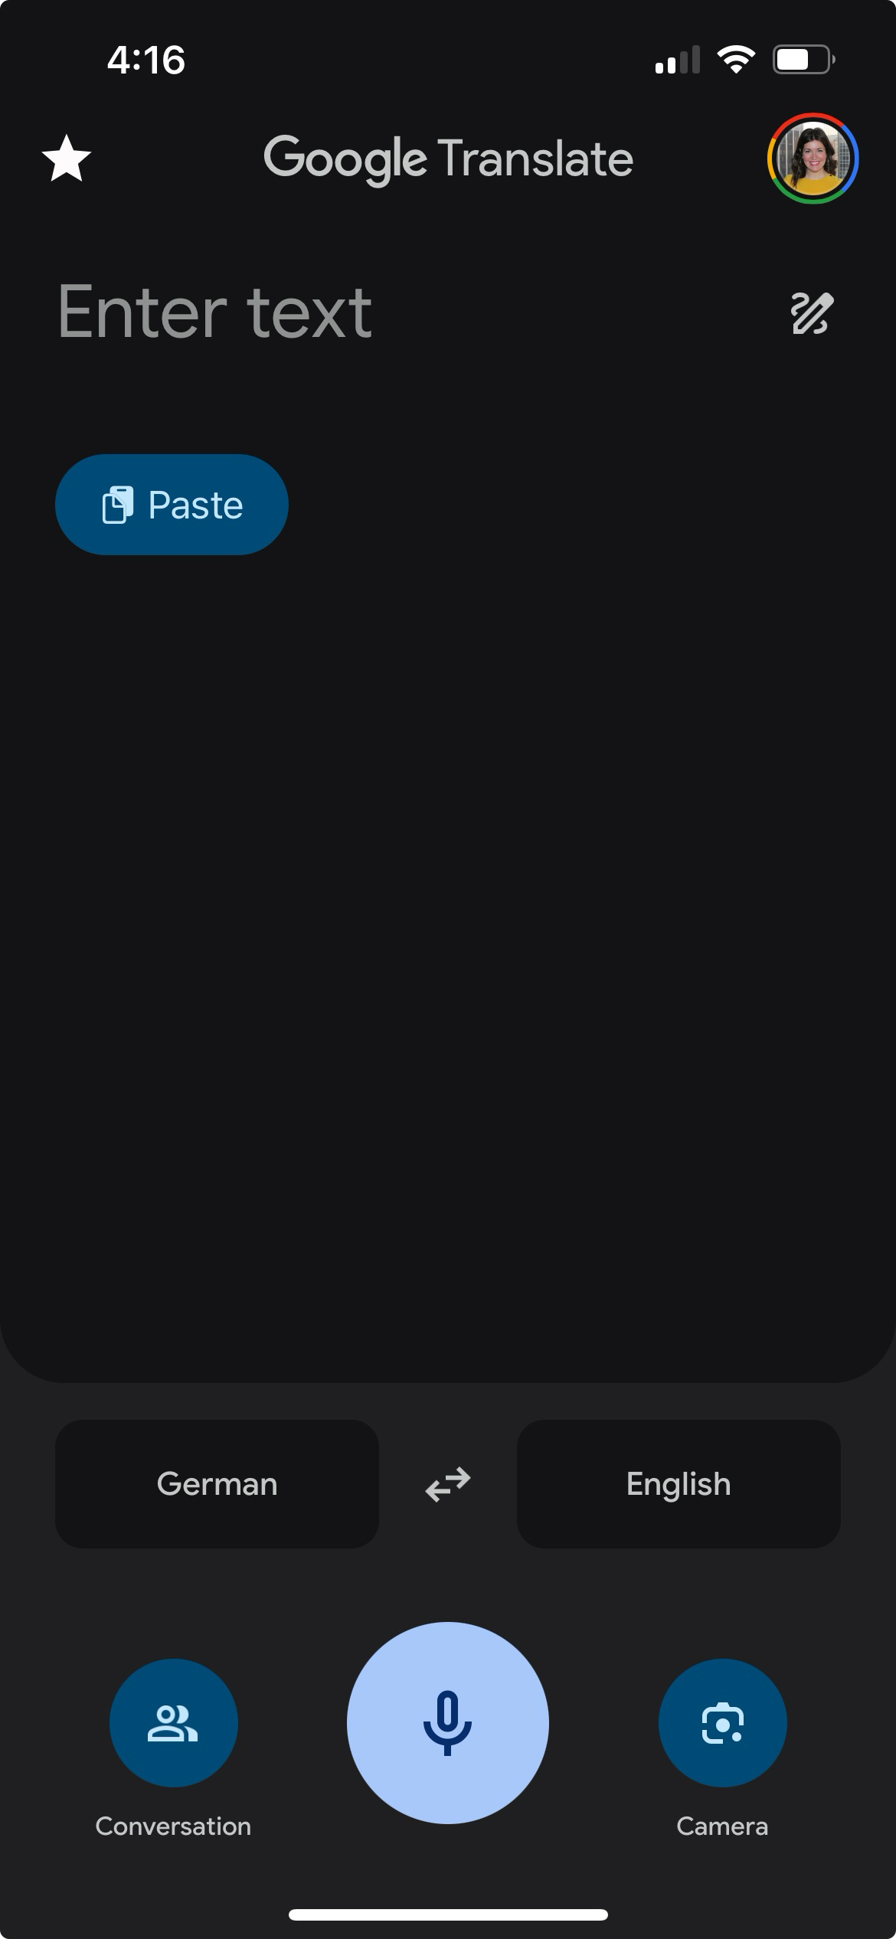
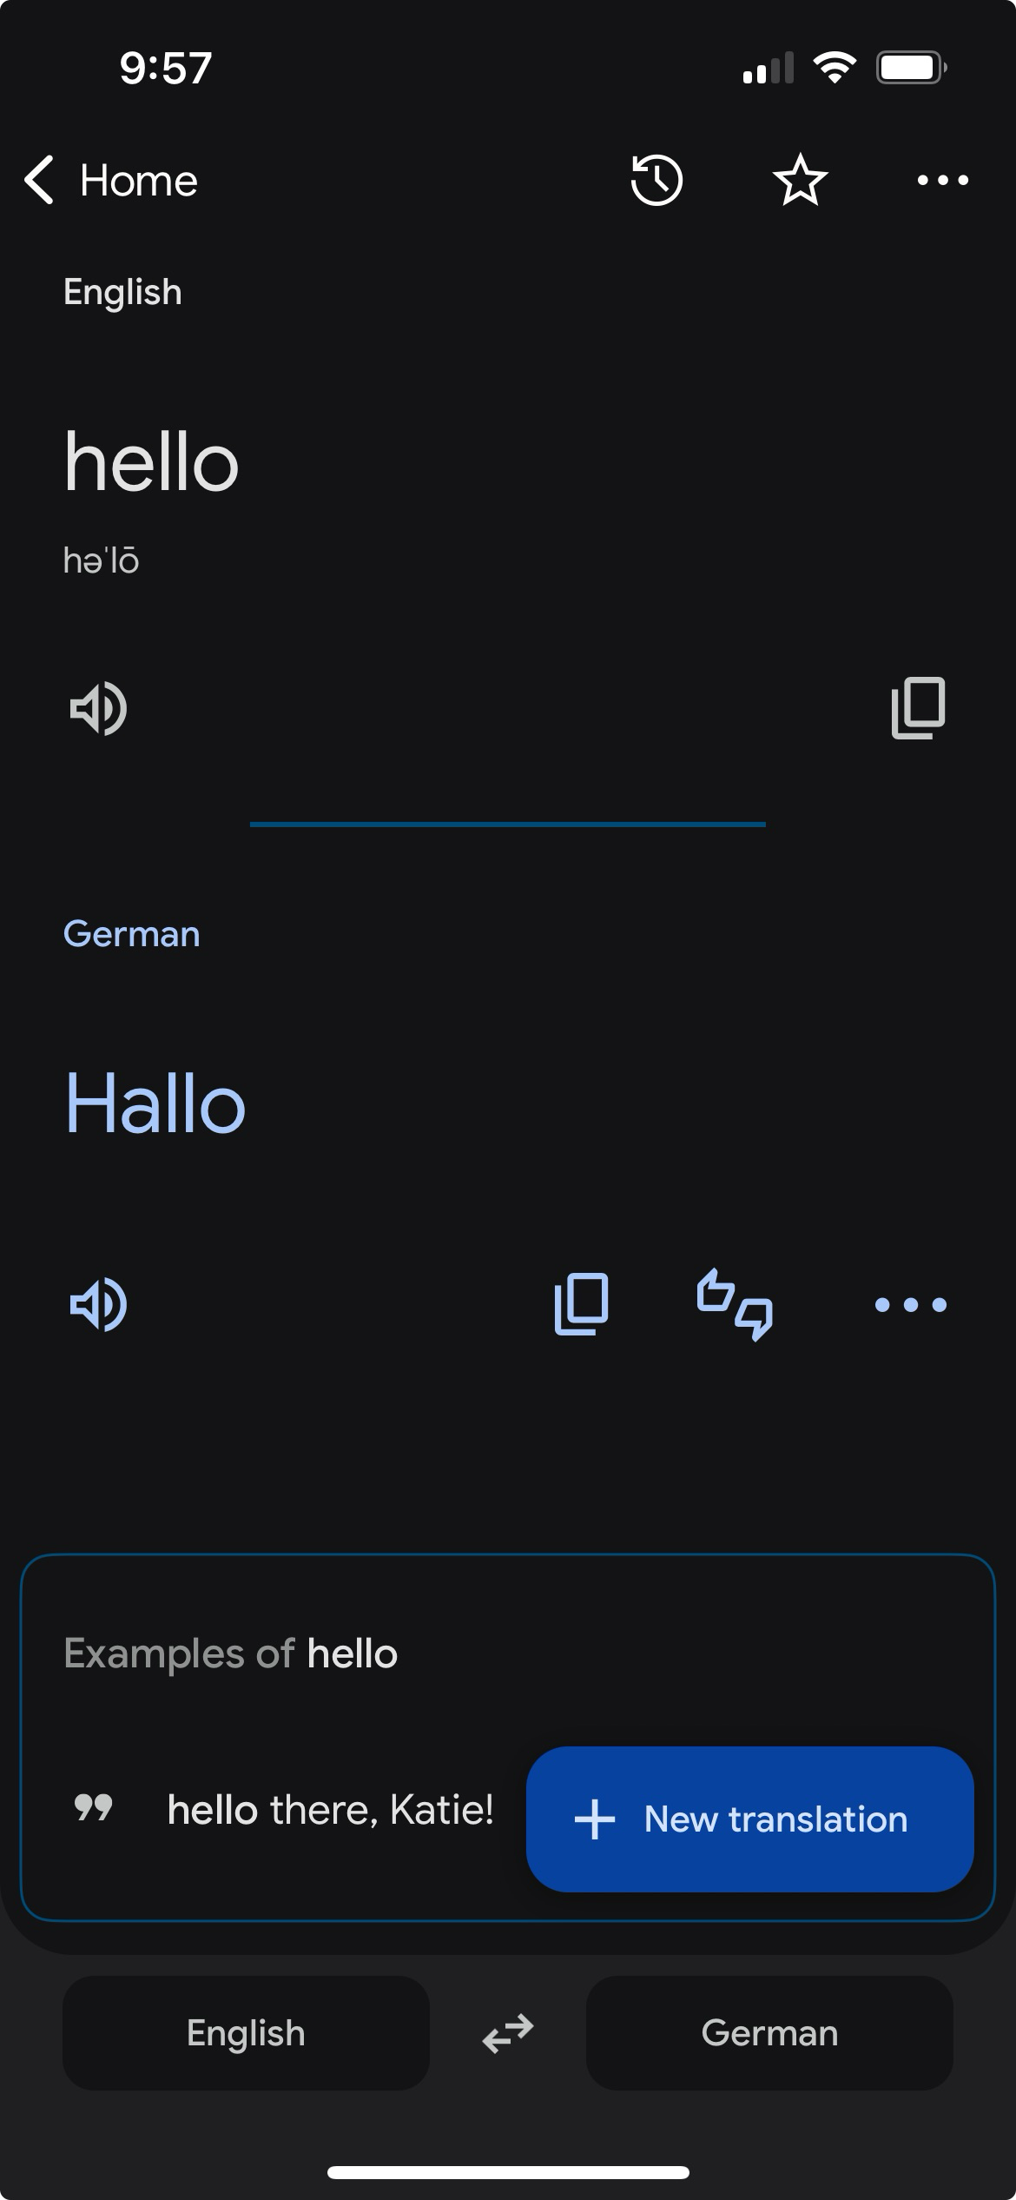
Suggested Apps
  Check your languages
    German → English or English → German depending upon the situation
  Camera is generally the most useful
    Restaurant menus
  For pronunciation
Google Translate

Slide 8
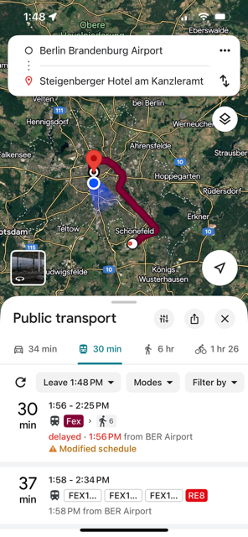
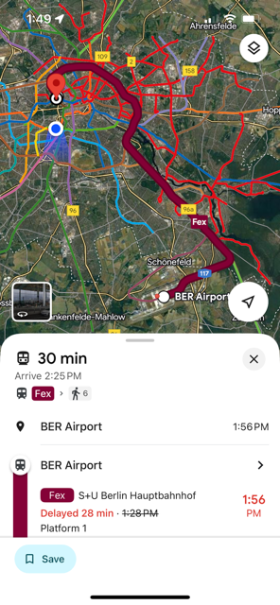
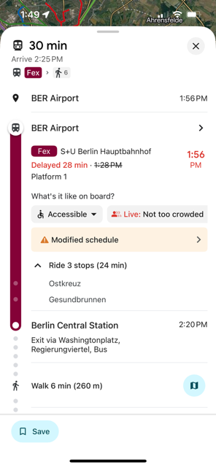
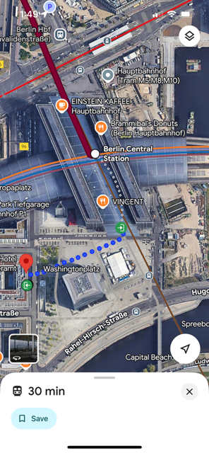
Google Maps – Navigation Basics

Slide 9
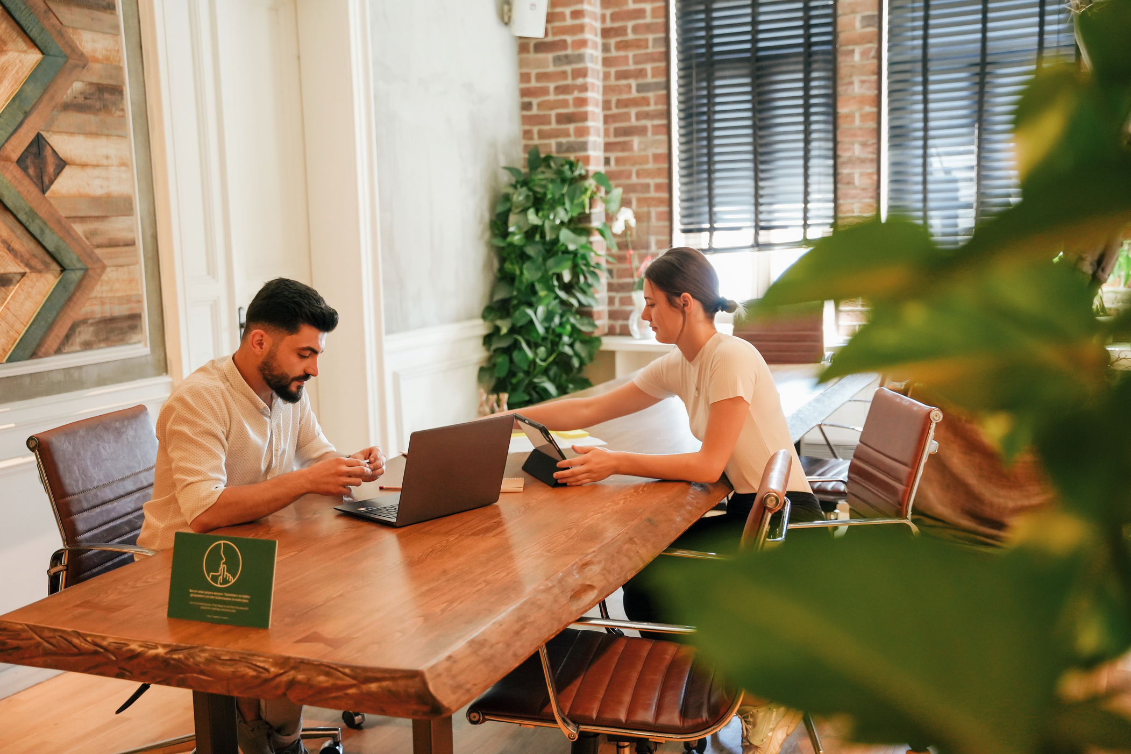

Suggested
Free Time Ideas
  Museum Island – world class museums
  Shopping – KaDeWe, Hackesche H⍤fe boutiques, Holzmarkt, Markthalle Neun (market hall with food)
  Urban art/art Installations – East Side Gallery, Dark Matter
  Sauna – cultural significance
Our Leadership Berlin experience has been life-altering for me as it has exposed so many nuances of Berlin and German culture. It was intellectually stimulating and fun, but more importantly it allowed me to form new friendships that I hope will last a lifetime!
-Ronald V. Johnson, Chief Ethics Officer, KeyBank

Slide 10
German Words/Phrases
English | German | Phonetic Pronunciation
Yes | Ja | (yah)
No | Nein | (nain)
Hello/Hi | Hallo | (ha⋅lo)
Bye | Tschüss/Tschau | (chüs/chow)
Thank you | Danke | (dang⋅ke)
Please | Bitte | (bi⋅te)
You’re welcome | Bitte | (bi⋅te)
Good morning | Guten Morgen | (goo⋅ten mawr⋅gen)
Good afternoon | Guten Tag | (goo⋅ten tahk)
Good evening | Guten Abend | (goo⋅ten ah⋅bent)
Bathroom? | Toiletten? | (to⋅a⋅le⋅ten)
Excuse me/Sorry | Entschuldigung | (ent⋅shul⋅di⋅gung)
No problem | Kein Problem | (kain pro⋅blaym)

Slide 11



Media Suggestions
Optional but thoughtfully curated media suggestions to enrich your experience. Exploring place or culture in advance can deepen your understanding and make the journey even more rewarding!
Watch
Read
Listen
Good Bye Lenin! (2003)
The Lives of Others (2006)
Berlin: Symphony of a Great City (1927)
When Hitler Stole Pink Rabbit (2019)
B-Movie: Lust & Sound in West Berlin (2015)
Ghost Dance in Berlin: A Rhapsody in Gray
Berlin Alexanderplatz
I Make Envy on Your Disco
Stasiland
History Flakes: The Berlin History Podcast
History of Germany
Radio Spätkauf
Slow German

Slide 12


THANK YOU
For Joining!
Natalie Yakunich
+49 172 2443090 (on WhatsApp)
Natalie.Yakunich@leadershipberlin.de

Slide 13
Airport to Hotel
Public transportation in Berlin is barrier-free, clean, convenient, and inexpensive! As Americans, we do not often find ourselves in a position to use public transportation, so I want to share the basics to help you feel empowered to use it here in Berlin.
Basics
You will not need to show a ticket to board public transportation as all public transportation is barrier free.
You will only present a ticket when an agent walks around the train asking to see one. However, things are primarily the honor system, and many individuals can spend time in Berlin and never once get asked to present their ticket.
  Fines are steep for those who choose to ride without
You could choose to install the BVG Tickets app ahead of time and purchase your ticket when you land and are ready to leave the airport OR you could buy a ticket at the machine at the airport
  If you purchase your ticket from a machine you may need to validate it
  TIP: if you use the app, you will not need to validate the ticket, so it requires fewer steps
From the airport to Central Berlin, you will need zones A,B,C
You will have a 7-day ticket made available to you when you arrive so securing your ticket for transportation is only necessary on this journey into Berlin upon your arrival

Slide 14
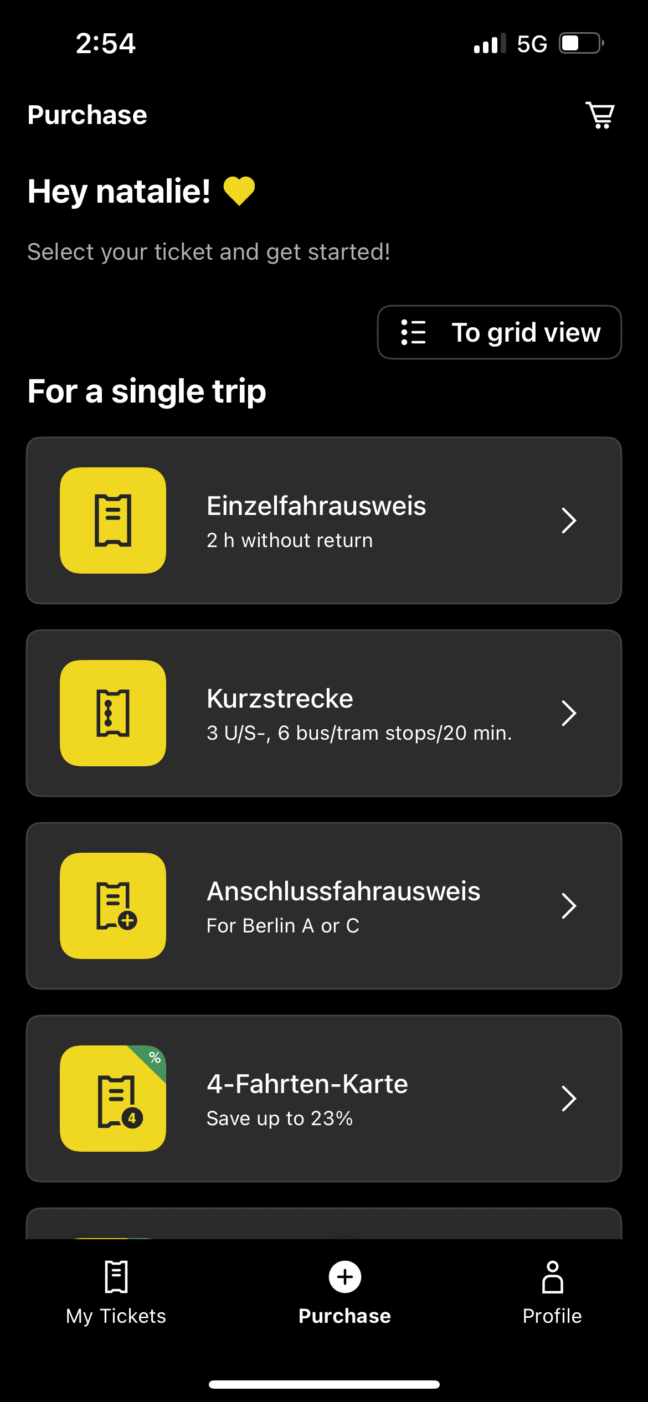
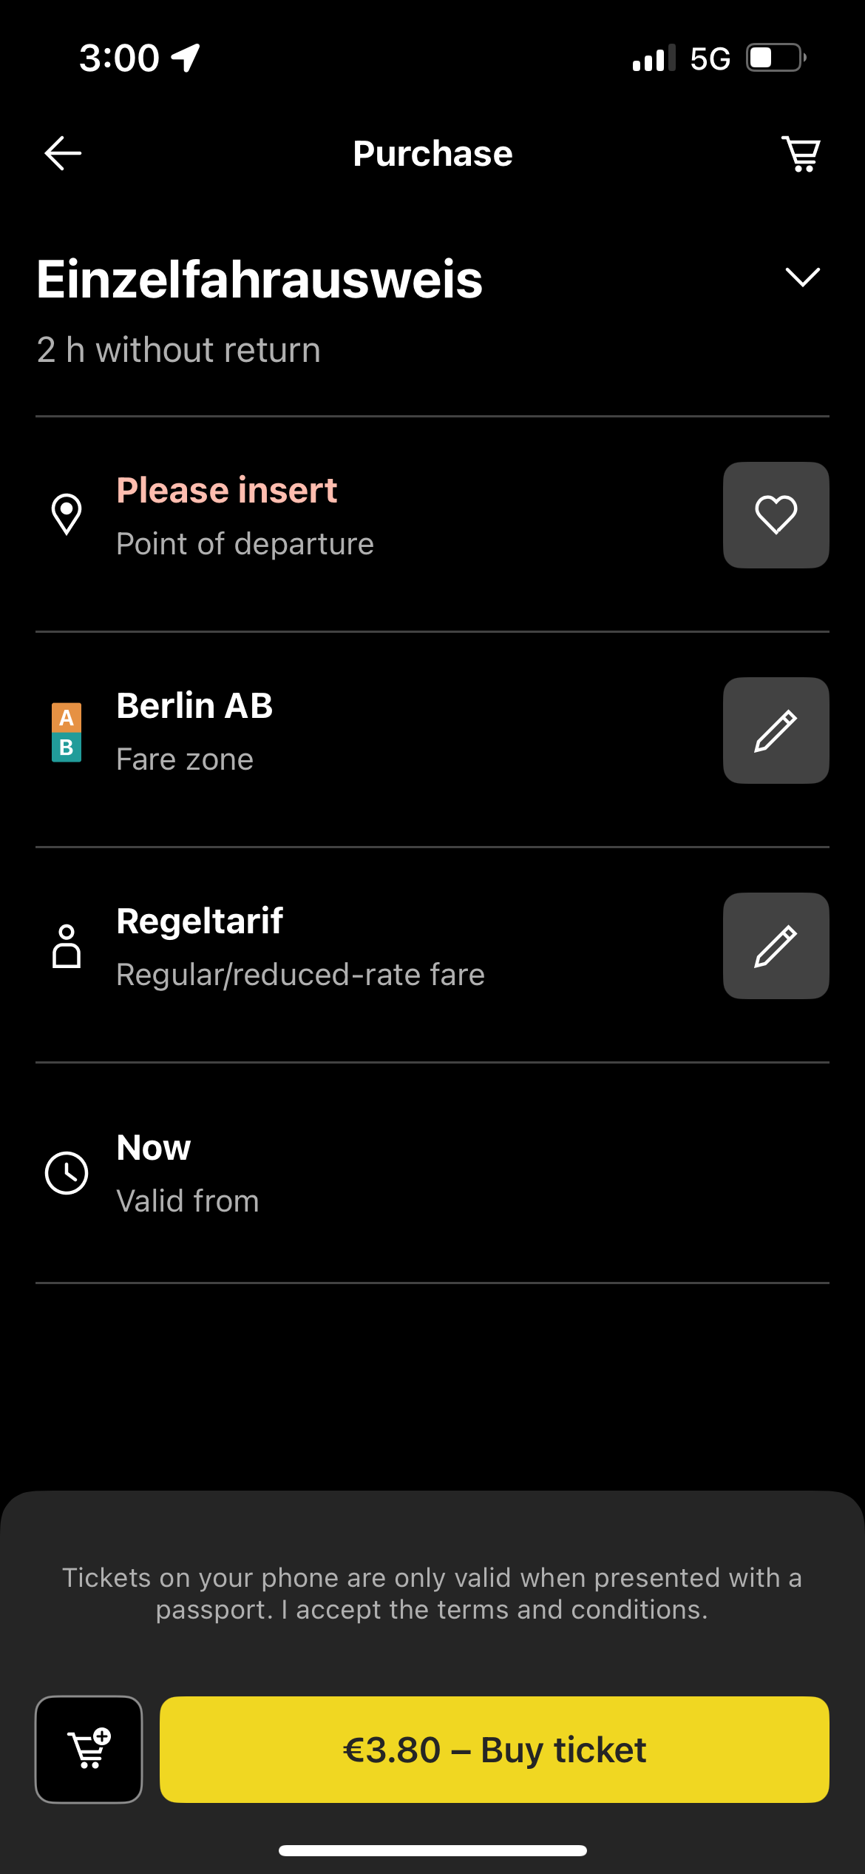
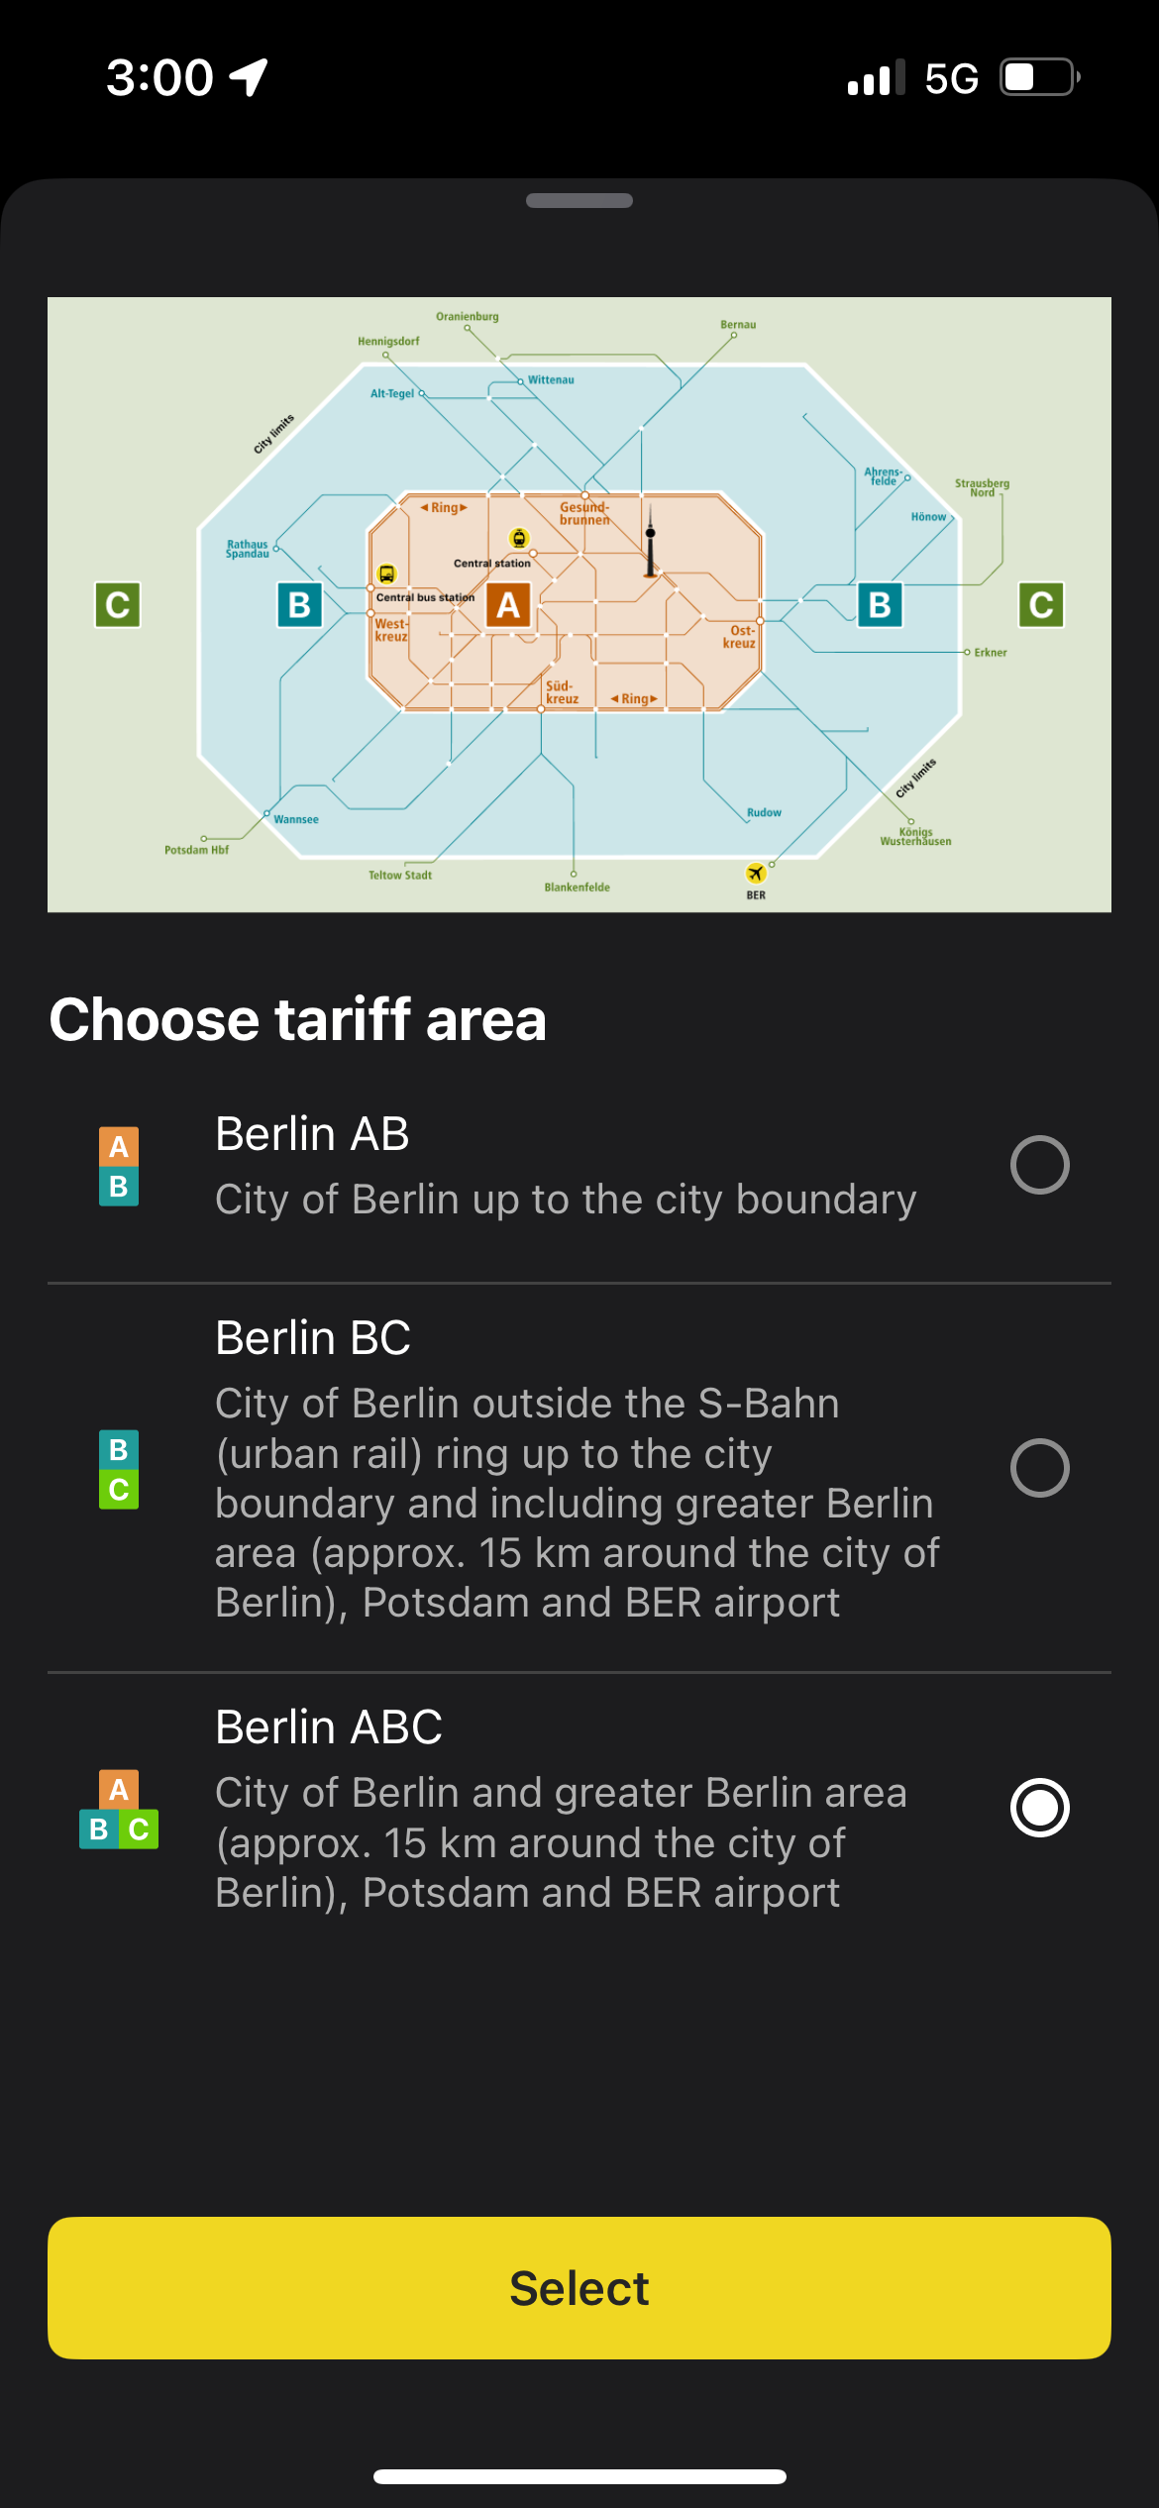
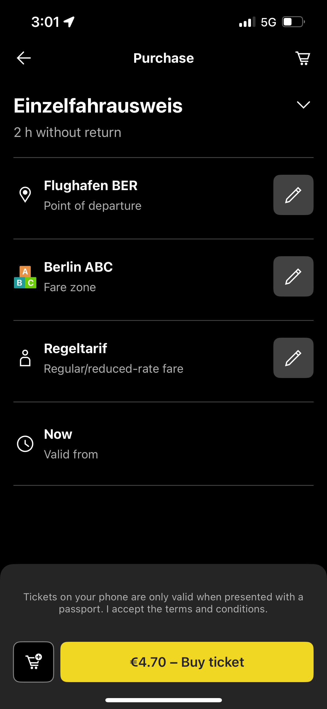

Airport to Hotel
Flughafen BER (Berlin Airport) to Steigenberger Hotel at the Chancellery
Steps in BVG Ticket App to purchase ticket
After connecting to the airport WIFI or connecting to the local network (preference based), open the BVG Tickets app
→TIP: register for the app while you are still in the US

